Slide 1

ICE IS
CALLING
Minus273
º

Slide 2
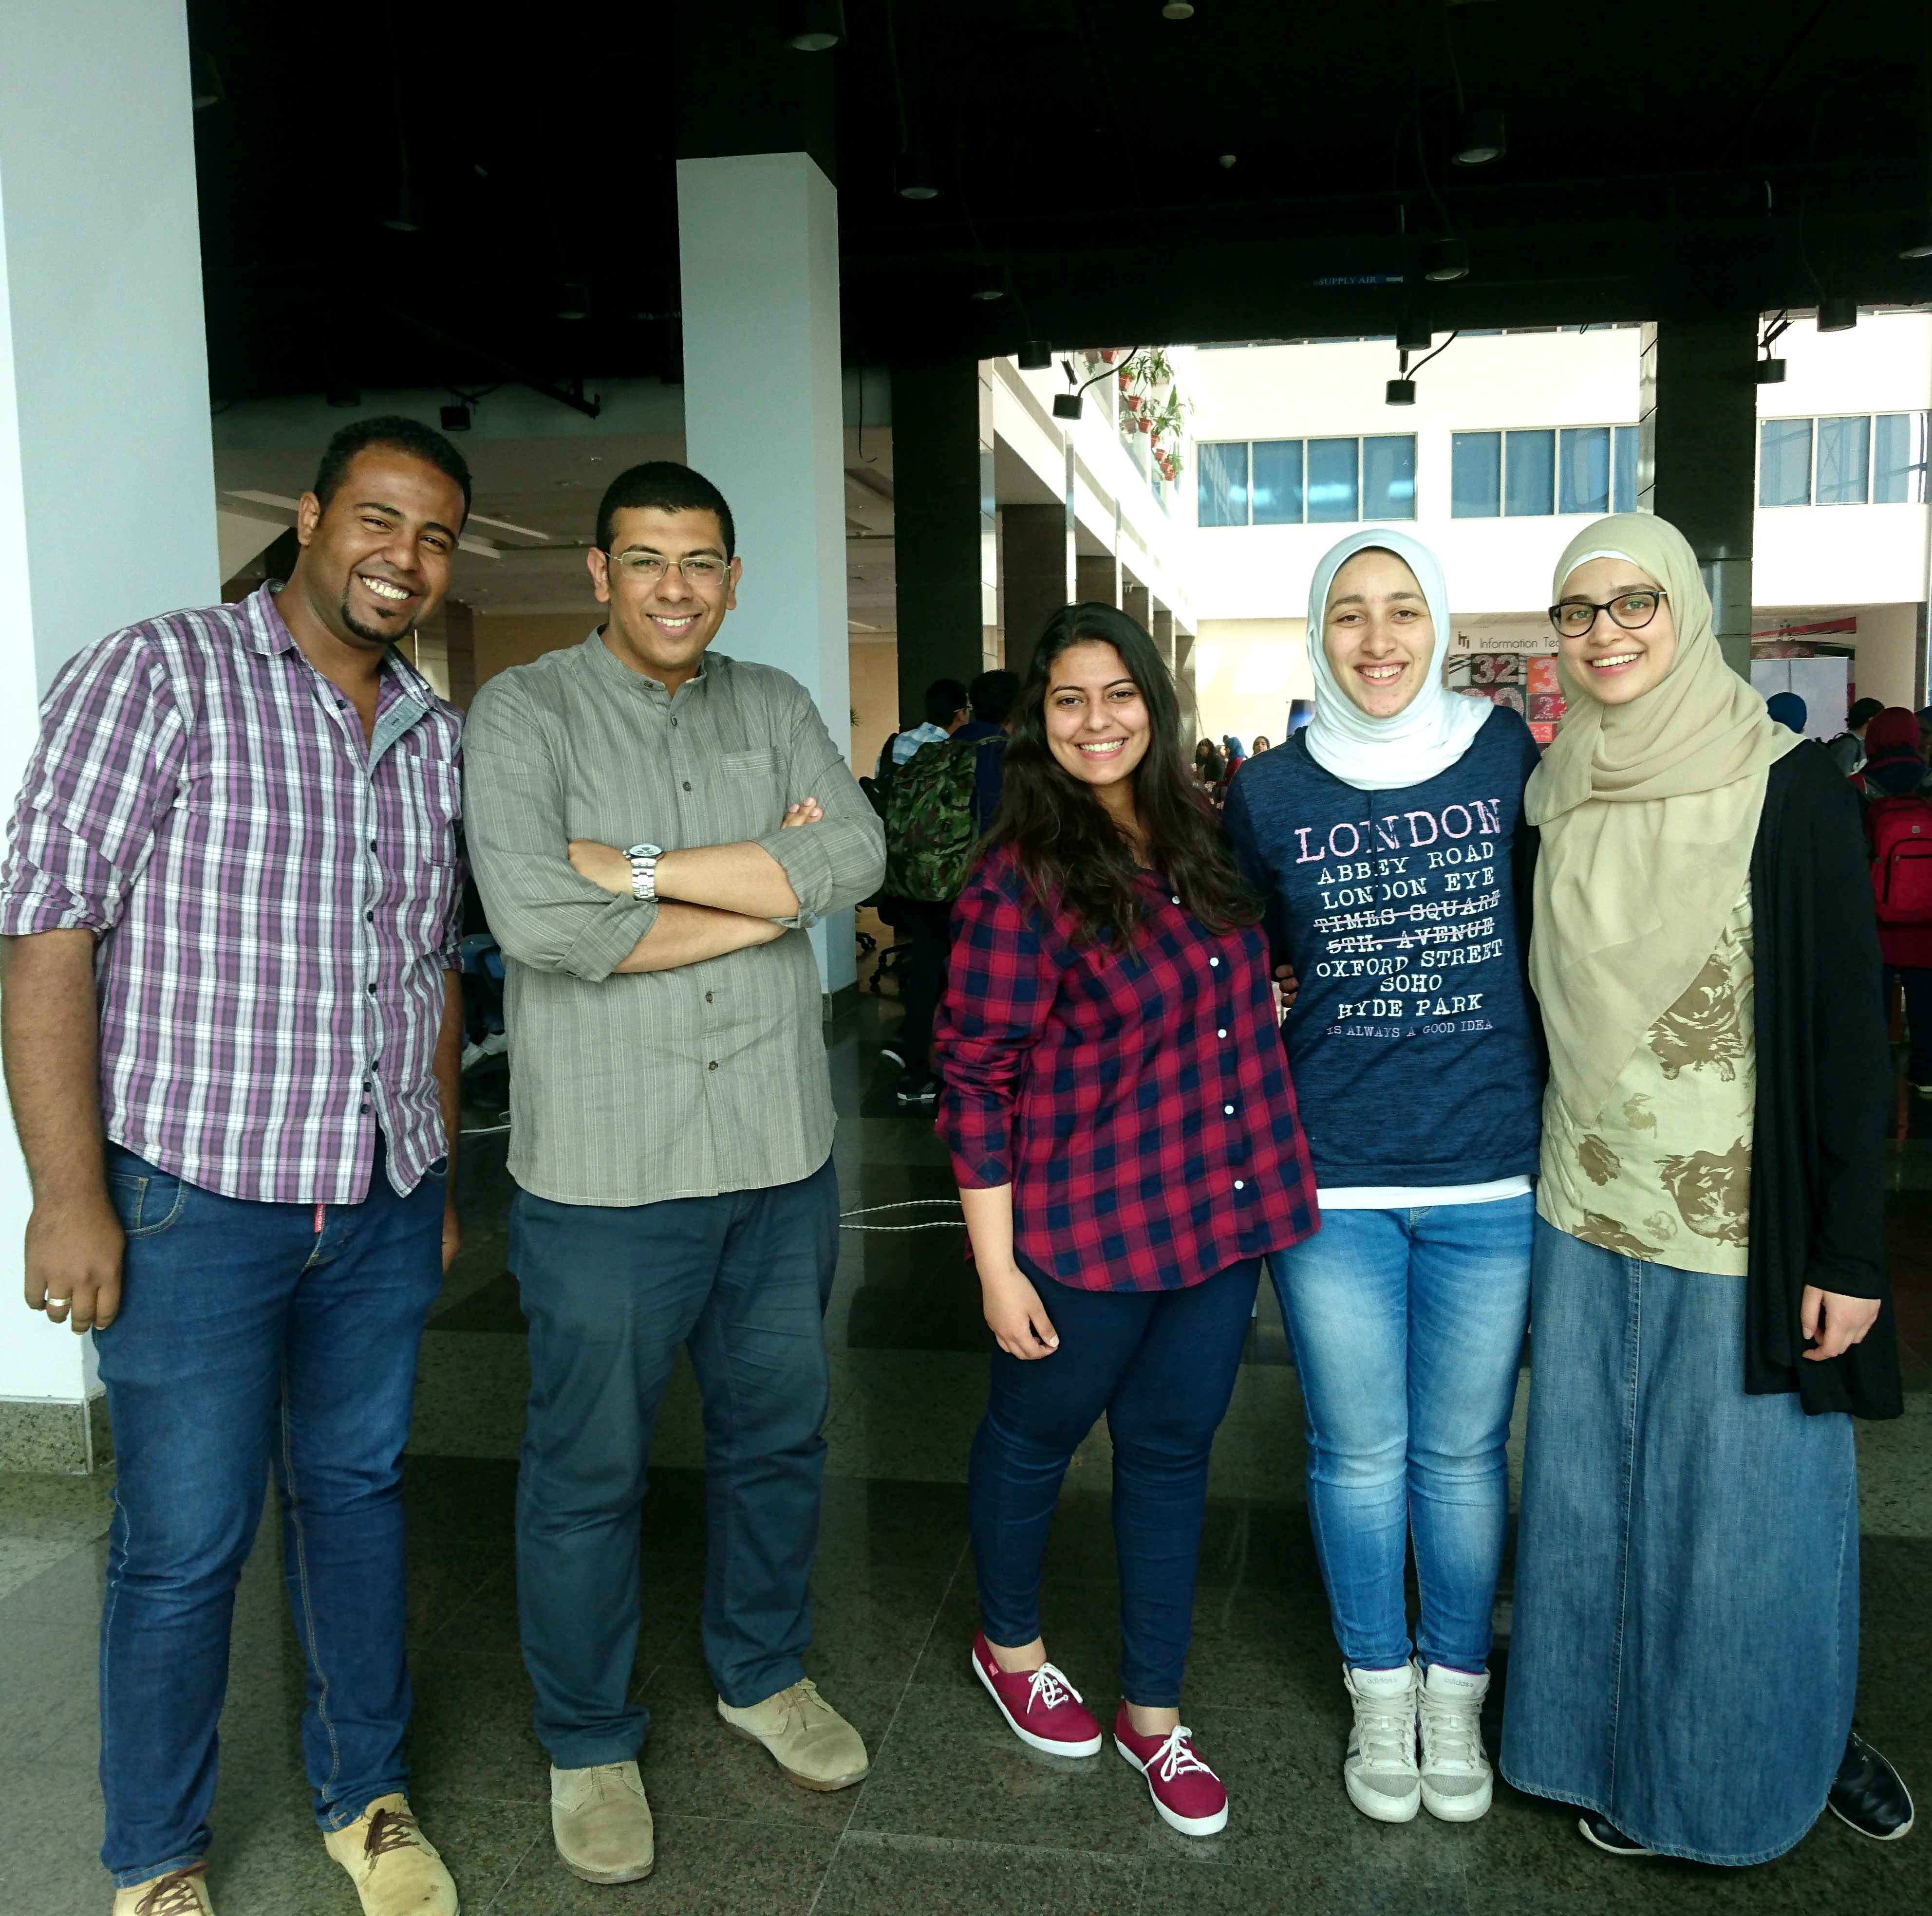
The Puzzle Blocks

Slide 3

Agenda
The Story
Positioning
Visualization Platform
Awareness Portal
Conclusion

Slide 4
The
Story

Slide 5
Positioning

Slide 6
Minus273º offers a comprehensive yet simple visualization solutions to support research and help spreading awareness concerning Earth’s ice content. Our solutions are easily accessible, affordable and appealing to various segments to ensure solutions’ sustainability and effectiveness.

Slide 7
The
Visualization
Platform

Slide 8
The
Awareness
Portal

Slide 9
What’s Next …

Slide 10
Thanks

